Slide 1
Welcome to
Year 2

Slide 2
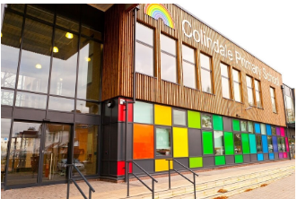
Staff Team
Phase Leader/Assistant Headteacher:
Miss Parmar
Teachers:
2T Miss Thompson
2C Mrs Cakmak
2N Miss Nuttall
Teaching Assistants:
2T Ms Constanti
2C Mrs Frunza
2N Ms Phillips

Slide 3
Routines
Parents/ Carers should bring their
children to the school gates between
8.40 and 9 am. The children can then
go directly into their classrooms/school by themselves.
Staff will be positioned around school to help children if they are not sure where to go.
Children should be collected at 3.15pm from outside their classroom. Please let your child’s teacher/ the office know if someone else will be picking them up.
On Thursday mornings the classes will be taught by other members of staff, including the PE coach – Coach Michael.
On Wednesday mornings classes will be taught by other members of staff:
2N – Miss Murphy
2C & 2T – Coach Michael & Miss Fernandez (swimming teacher)

Slide 4
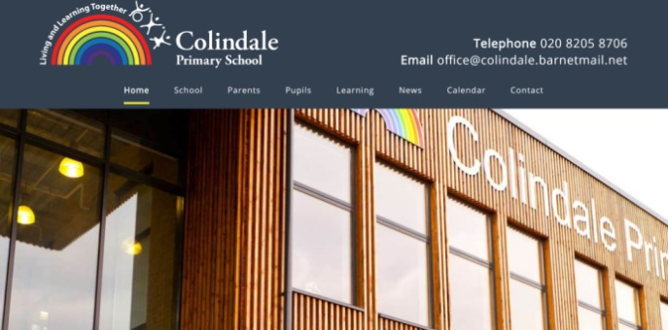
Punctuality and attendance
Coming to school every day is essential to your child’s progress, especially after so much time out of school over the last two years. It will also help your child transition well into Year 2 if they are consistently at school.
However, should your child be unwell, please phone the school in the morning and let the office know.
If your child has a symptom of coronavirus – persistent cough, temperature, loss of taste or smell – you need to book a test and self-isolate until the results come back. Please let the school office know.
Remember - holidays should be taken in holiday time and if they are not, parents will be fined.

Slide 5
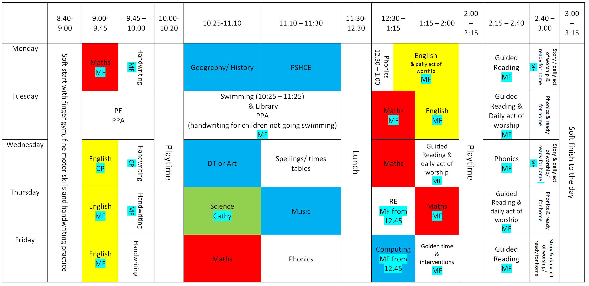
Year 2 Timetable
Soft start from 8.40-9am.
Register taken at 9 am.
Playtime is from 10.00-10.15am & 2.00 – 2.15pm
Lunchtime is from 12.00 – 1.00pm
Example Year 2 timetable
Swimming:
2T Wednesday
2C Wednesday
2N Thursday
PE:
2T Wednesday (9am)
2C Wednesday
2N Monday

Slide 6
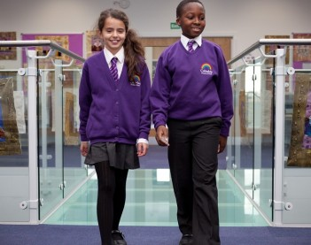
Uniform
It is very important that your child has the
correct uniform and that all of it is labelled with
name and class.
If your child’s class has PE as the first session of the day, the children may come dressed in their PE kits but will need to have their school uniform as well.
Please practise the following:
changing in and out of uniform
turning jumpers, trousers and tights the right way round
getting in and out of a dry and wet swimming kit
This will help your child be more independent.
Please note that no jewellery is allowed. If your child has pierced ears they may wear small studs. If jewellery is worn for religious reasons please see your child’s teacher to ensure it meets health and safety requirements.

Slide 7
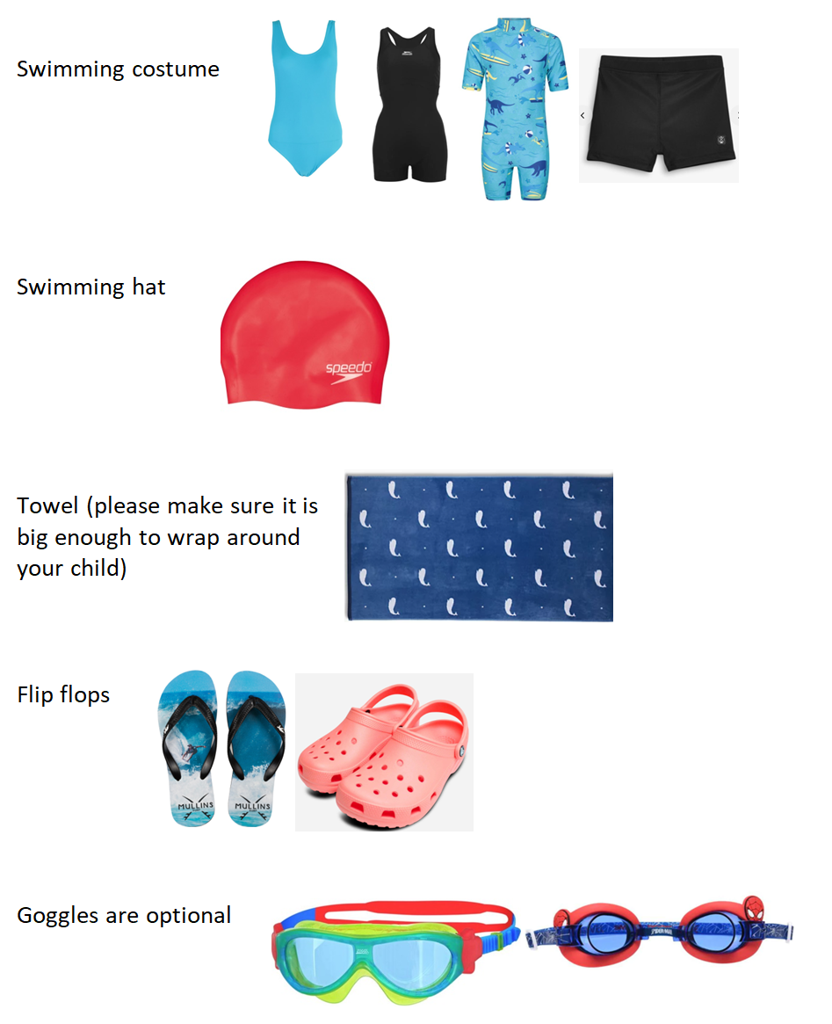
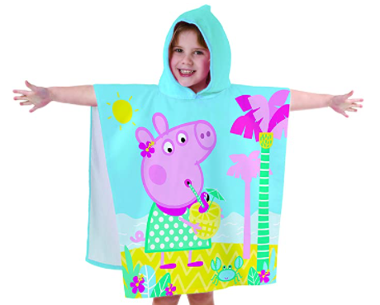
PE and swimming kits
PE kits should be sent in on Mondays and will be sent home on Fridays.
Swimming kits should be sent in when your child is swimming. Please check the timetable outside the classroom.
Please ensure that both kits are provided in separate labelled bags.

Slide 8
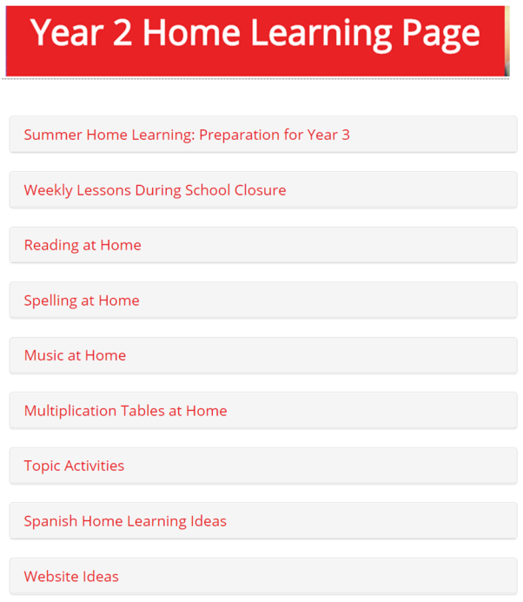
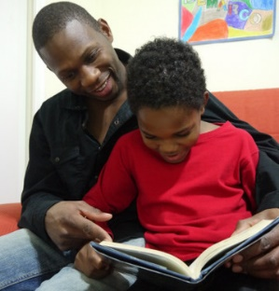
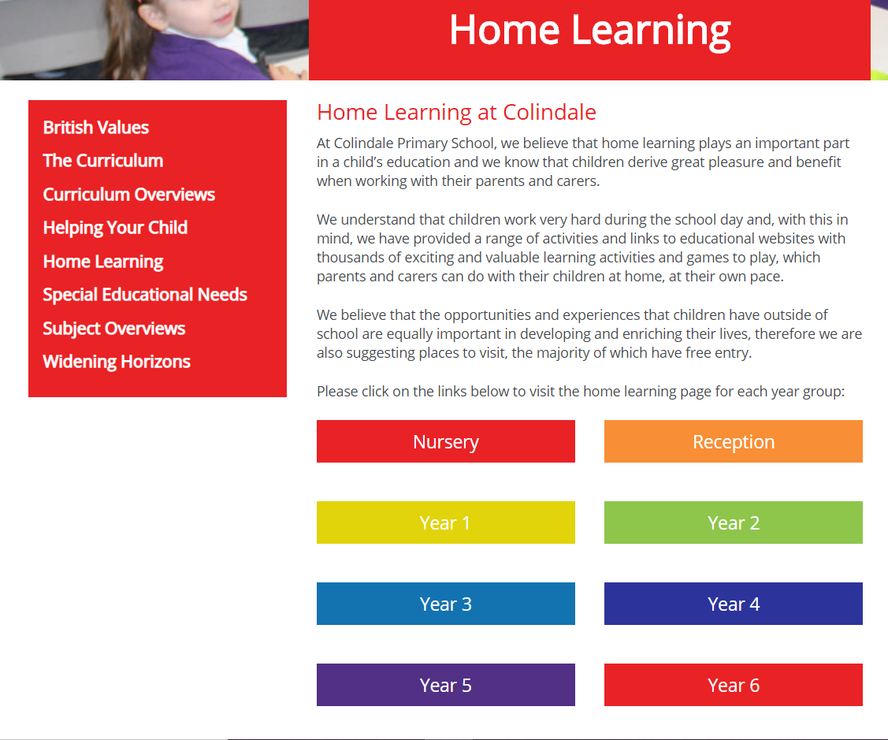
Home Learning
Access through School website:
You can click on the link below for direct access:
https://www.colindale.barnet.sch.uk/year-2-home-learning-page/

Slide 9
Year 2 Topics
Autumn Term (see curriculum overviews):
London
Famous People (including Black History Month)
Spring Term:
Tales around the world
Summer Term:
Natural World
Seasides
Trips
London Eye & River Boat Cruise – Autumn 1/2
RAF Museum – Spring 1
Clacton-On-Sea – Summer 2

Slide 10
Communicating with your child's teacher
If you wish to speak to your child’s teacher:
Ring or email the office to make an appointment with your child's teacher for after school
Have brief informal conversations after school at pick up
Use the year group email: Year2@colindale.barnetmail.net (for non-emergency messages)
Parent Consultations for all children will take place in October.

Slide 11
School website
Please use the school website regularly to check for upcoming events and important dates.
All letters are on the website-– you will be informed of new letters by text (ensure school have your up-to-date contact details)
Curriculum overviews will provide information about what will be taught during each term
There is also a section for every subject where you can see what will be taught over the year- Subject overviews
https://www.colindale.barnet.sch.uk/

Slide 12
Any questions?

