Slide 1
Welcome to
Year 3

Slide 2
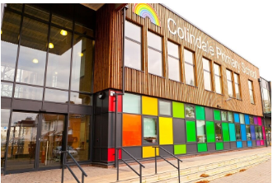
Staff Team
Phase Leader/Assistant Headteacher:
Mrs. Averbrook
Teachers:
3F Mrs Fernandez
3K Mrs Khan
3G Mrs Grigoriadou
Teaching Assistant: Miss Din

Slide 3
Routines
Parents/ Carers should bring their
children to the school gates between
8.40 and 9 am. The children can then
go directly into their classrooms by themselves.
Staff will be positioned around school to remind the children about how to use the one-way system
If you wish to speak to your child’s teacher please make an appointment by contacting the office, or via the year group email Year3@colindale.barnetmail.net

Slide 4
Punctuality and attendance
Coming to school every day is essential to your child’s progress, especially after so much time out of school last year. It will also help your child transition well into the Juniors if they are consistently at school.
However, should your child be unwell, please phone the school in the morning and let the office know.
If your child has a symptom of coronavirus – persistent cough, temperature, loss of taste or smell – you need to book a test and self-isolate until the results come back. Please let the school office know.
Remember - holidays should be taken in holiday time and if they are not, parents will be fined.

Slide 5
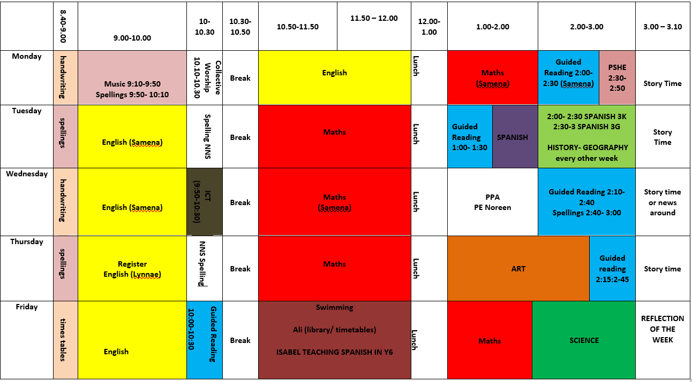
Year 3 Timetable
Staggered soft start from 8.40-9 am.
Register taken at 9 am.
Playtime is from 10.30-10.50 am daily
Lunchtime is from 12-1 pm
Example Year 3 timetable
Swimming:
3F Friday
3G Wednesday
3K Wednesday
PE:
3F Wednesday
3G Wednesday
3K Wednesday

Slide 6
PE Kit

Slide 7
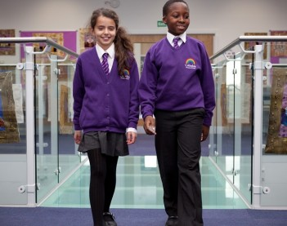
Uniform
It is very important that your child
has the correct uniform and that all
of it is labelled with name and class.
Year 3 children are expected to wear a school tie and shirt (not polo shirts).
PE kits should consist of:
Black jogging bottoms/ leggings
White t-shirt
Black or white plimsolls/trainers for outside
If your child’s class has PE as the first session of the day, the children may come dressed in their PE kits but will need to have their school uniform as well.

Slide 8
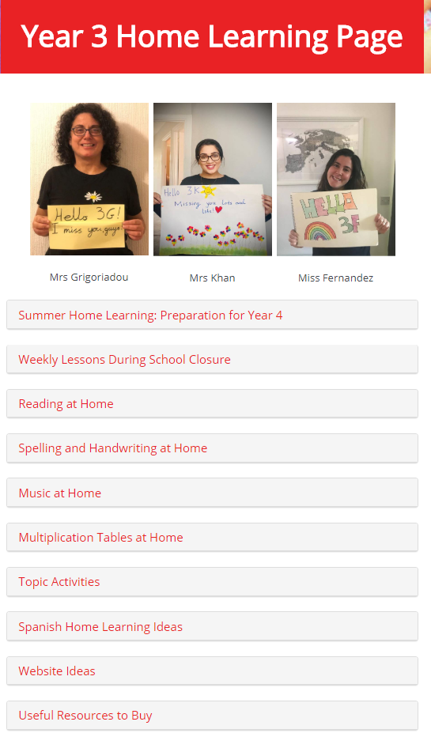
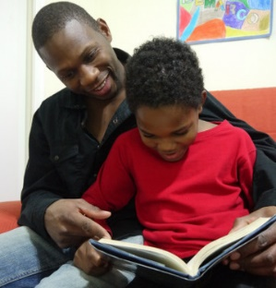
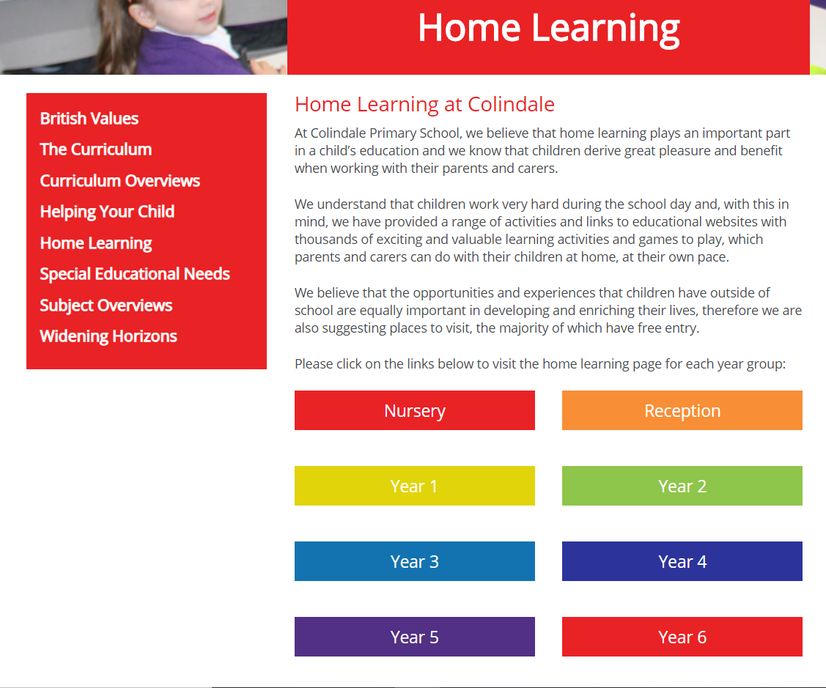
Home Learning
Access through School website:
You can click on the link below for direct access:
https://www.colindale.barnet.sch.uk/year-3-home-learning-page/

Slide 9
Year 3 Topics
Autumn Term (see curriculum overviews):
Stone Age, Iron Age and Bronze Age
Black History Month
Let’s Play- trip to Rushgrove park for science investigation
Spring Term:
Our World
Summer Term:
Ancient Egypt
We are only able to have local trips at present, but hope this will change as the year goes on.

Slide 10
Communicating with your child's teacher
We appreciate this is more difficult at the moment, but you can:
Ring or email the office to make an appointment with your child's teacher
appointments can be after school in an outside area
or a space can be booked in school for conversations that are more confidential.
Have brief informal conversations after school at pick up
Use the year group email: Year3@colindale.barnetmail.net
Parent Consultations for all children will take place virtually on the 20th and 22nd October- information to follow

Slide 11
School website
Please use the school website regularly to check for upcoming events and important dates.
All letters are on the website-– you will be informed of new letters by text (ensure school have your up-to-date contact details)
Curriculum overviews will provide information about what will be taught during each term
There is also a section for every subject where you can see what will be taught over the year- Subject overviews
https://www.colindale.barnet.sch.uk/

Slide 12
Any questions?
Write to us on the year group email:
Year3@colindale.barnetmail.net

