Slide 1
Welcome to
Year 1

Slide 2
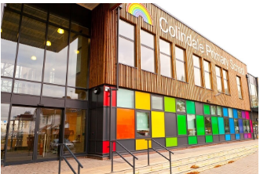
Staff Team
Phase Leader/Assistant Headteacher:
Miss Parmar
Teachers:
1FS Ms Simpson (Mon – Wed) & Mrs Fumagalli (Wed – Fri)
1A Mrs Andreou
1M Miss McCague
Teaching Assistants:
1FS Mrs Frunza
1A Ms Phillips
1M Ms Constanti

Slide 3
Routines
Parents/ Carers should bring their
children to the classroom door
between 8.40 and 9 am.
Please drop your child off and leave the premises as quickly as you can in order ensure the continuation of social distancing.
If you wish to speak to your child’s teacher please make an appointment by contacting the office, or via the year group email Year1@colindale.barnetmail.net

Slide 4
Punctuality and attendance
Coming to school every day is essential to your child’s progress, especially after so much time out of school last year.
However, should your child be unwell, please phone the school in the morning and let the office know.
If your child has a symptom of coronavirus – persistent cough, temperature, loss of taste or smell – you need to book a test and self-isolate until the results come back. Please let the school office know.
Remember - holidays should be taken in holiday time and if they are not, parents will be fined.

Slide 5
Year 1 Timetable
The following times will remain the same for the foreseeable future:
Staggered soft start from 8.40-9am.
Register taken at 9 am.
Playtime is from 10.00-10.20am & 2.00 – 2.15pm
Lunchtime is from 11.30 – 12.30pm
For the first 2 weeks of term children work in small adult led groups in order to help them settle into their new class and new routines.
From around the 3rd week of term children begin transitioning into a slightly more typical way of learning in Year 1. This includes short daily sessions in English, maths, phonics, guided reading and topic.
During all English and most topic lessons, children continue to work in small adult led groups whilst others can free flow around the classroom, completing various activities through playing, reading and writing.
There are many opportunities for children to continue to learn through play, just as they would have done in Reception.
All lessons are based on the content of the Year 1 curriculum, which can be found on the Learning page of school website.

Slide 6
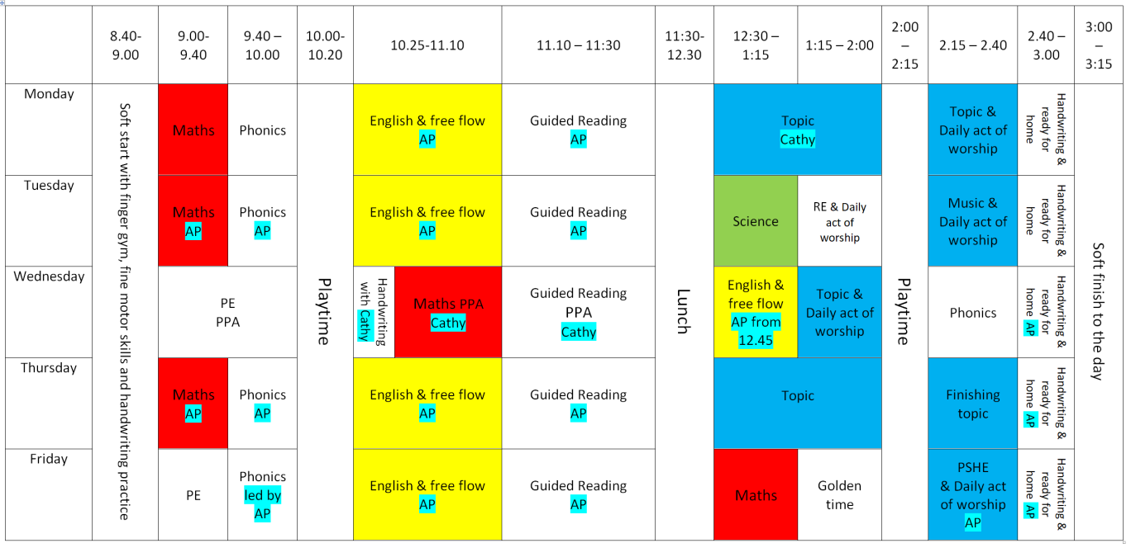
Year 1 Timetable
All through the 1st half of Autumn term teachers constantly review how children have settled in; how they are coping with new learning strategies and when to transition them into a full Year 1 timetable.
Typically after the Autumn half term, children transition into a full timetable - an example timetable is shown below.
Example Year 1 timetable
Each Year 1 class will have 2 PE sessions a week:
- 1FS: Wednesday & Thursday
- 1A: Wednesday & Friday
- 1M: Monday & Wednesday

Slide 7
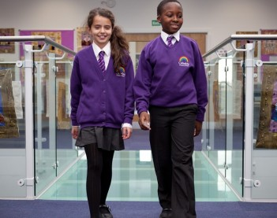
Uniform
It is very important that your child has the
correct uniform and that all of it is labelled with
name and class.
If your child’s class has PE as the first session of the day, the children may come dressed in their PE kits, but will need to have their school uniform as well.
Please practise the following:
changing in and out of uniform
turning jumpers, trousers and tights the right way round
changing in and out of PE kits
This will help your child to be more independent.
Please note that no jewellery is allowed. If your child has pierced ears they may wear small studs. If jewellery is worn for religious reasons, please see your child’s teacher to ensure it meets health and safety requirements.

Slide 8
PE kits
PE kits should be sent in on Monday and will be sent home on Friday.
Please ensure that PE kits are provided in separate labelled bags and not put in book bags.

Slide 9
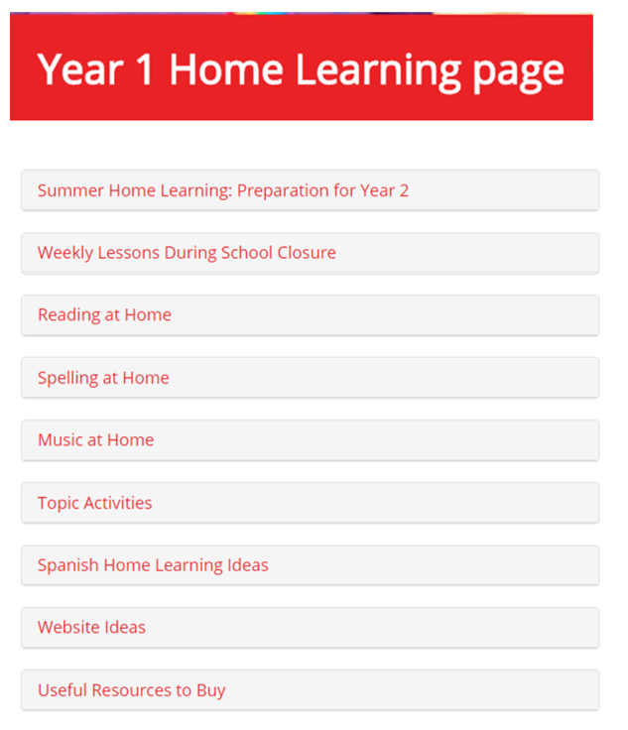
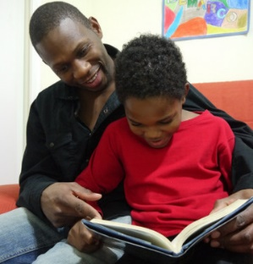
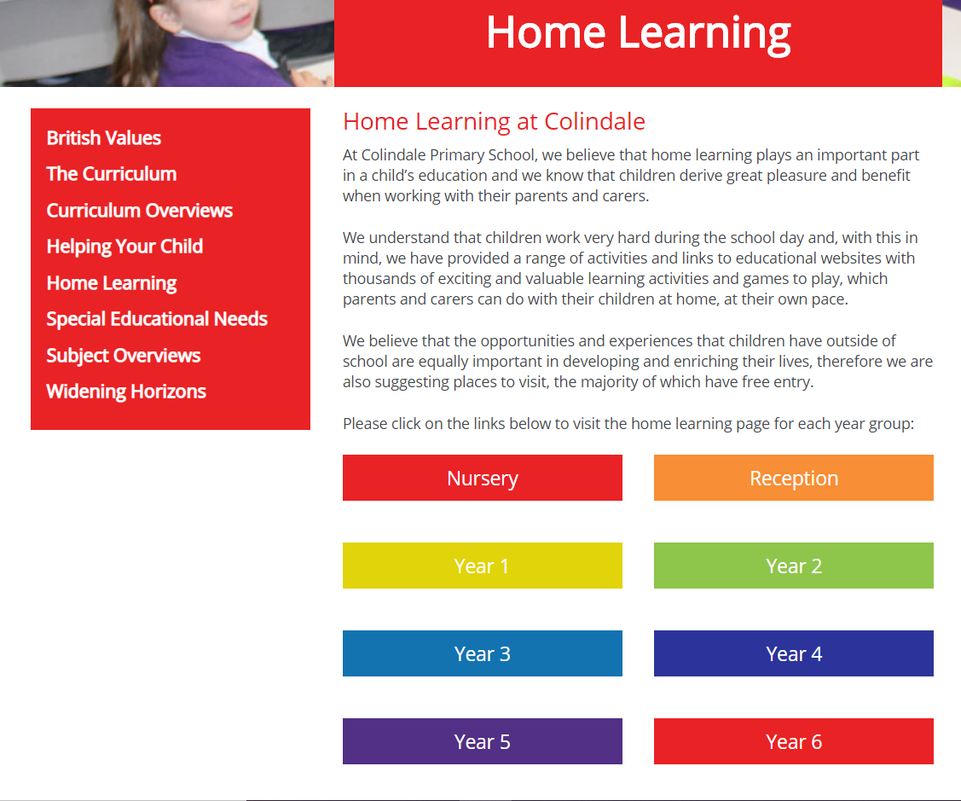
Home Learning
Access through School website:
You can click on the link below for direct access:
https://www.colindale.barnet.sch.uk/year-1-home-learning-page/

Slide 10
Year 1 Topics
Autumn Term (see curriculum overviews):
Marvellous Me!
Traditional Tales (including Black History Month)
Spring Term:
Transport
Animals
Summer Term:
Heroes & Heroines
Under The Sea
We are only able to have local trips and visitors into school at present, but hope this will change as the year goes on.

Slide 11
Communicating with your child's teacher
We appreciate this is more difficult at the moment, but you can:
Ring or email the office to make an appointment with your child's teacher
appointments can be after school in an outside area
or a space can be booked in school for conversations that are more confidential.
Have brief informal conversations after school at pick up
Use the year group email: Year1@colindale.barnetmail.net
Parent Consultations for all children will take place virtually on the 20th and 22nd October- information to follow

Slide 12
School website
Please use the school website regularly to check for upcoming events and important dates.
All letters are on the website-– you will be informed of new letters by text (ensure school have your up-to-date contact details)
Curriculum overviews will provide information about what will be taught during each term
There is also a section for every subject where you can see what will be taught over the year- Subject overviews
https://www.colindale.barnet.sch.uk/

Slide 13
Any questions?
Write to us on the year group email:
Year1@colindale.barnetmail.net

