Slide 1
Transfer to Secondary School

Slide 2
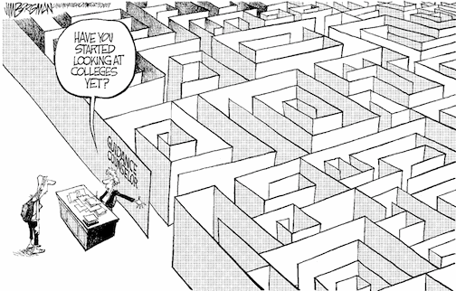
Choosing a school
Have you
started
looking
at schools
yet?

Slide 3
Choosing a school
How do I know which school is right for my child?
Who can help me make that decision?

Slide 4
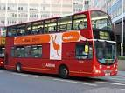
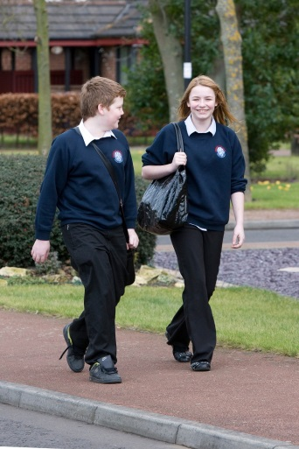
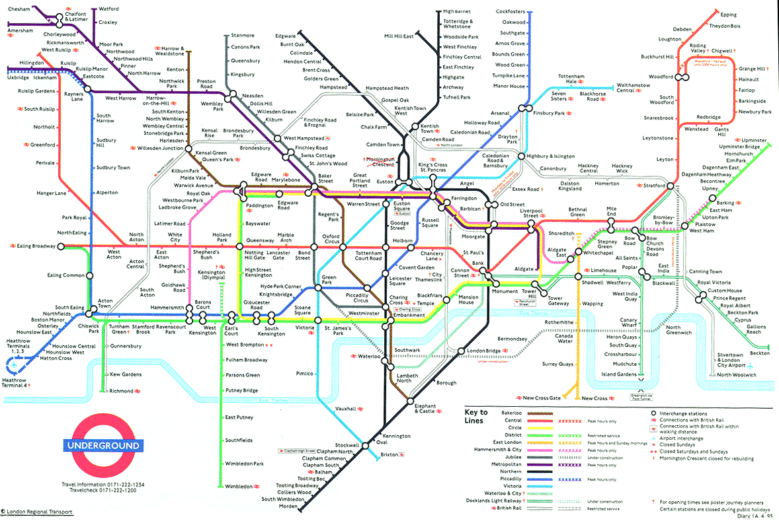
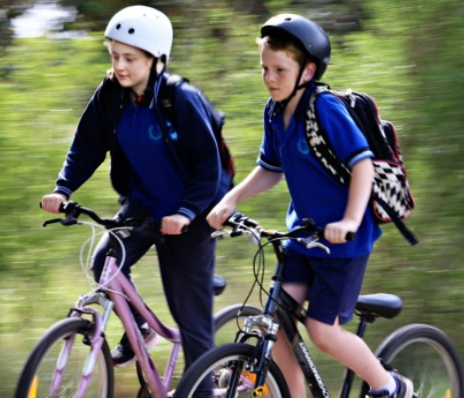
Choosing a school
Talk to your child
find out what they want
consider how they will travel to school

Slide 5
Choosing a school
Visit the schools
attend open evenings
talk to the teachers
talk to the pupils
When are the open evenings?
During September and October 2023 (Dates to be confirmed).

Slide 6
Choosing a school
Read the school prospectus
it will have detailed information about:
how the school is run
which subjects are taught
the admissions criteria
available at the open evenings
download from the school website

Slide 7
Choosing a school
Read the secondary education guide published by your home local authority – describes each school
the 2024 guide will be available online in September 2023
download Barnet’s guide at www.barnet.gov.uk/schooladmissions
Download Brent's guide at schools-admissions-brochure-2023_secondary_final.pdf (brent.gov.uk)

Slide 8
Choosing a school
Talk to the Customer Service Team
the team can offer you advice and answer your questions
how do I contact them?
tel: 020 8359 7651
Contact Us online
if you live outside Barnet, you will find the contact details for your admissions team in Barnet’s secondary education guide

Slide 9
Choosing a school
Look at performance information online
the latest Ofsted reports are available from the Ofsted website www.ofsted.gov.uk
achievement and attainment tables are available at www.gov.uk/school-performance-tables

Slide 10
Choosing a school
Look carefully at the admission criteria for each school
selection by aptitude / ability bands
faith criteria
siblings
Geographical distance
Remember most schools get more applications than they have places available.………

Slide 11
Choosing a school
Geographical distance for schools that were unable to offer to all applicants
Name of School | Furthest distance offered (Miles)
Archer Academy | 0.255 (N2) 0.992 (N3) 1.62 (NW11)
Ark Pioneer | 1.409
Bishop Douglass | All applicants accepted
Christ College | 1.287
Copthall (Girls) | All applicants accepted
Hendon School | All applicants accepted
London Academy | 2.099
Mill Hill High | 1.343
Queen Elizabeth’s Boys | Academic ability
Saracens High | 0.915
St James Catholic High | All applicants accepted
St Mary’s & St John’s (SMSJ) | Depends on band 0.59 – 2.232
Totteridge Academy | 1.646
Whitefield | All applicants accepted
Full Secondary 2023 Allocation Table can be viewed at:
Schools allocation table 2023 (OCT, 48 KB) | Barnet Council

Slide 12
How do I apply?
How soon can I apply?
the application process begins on 1 September 2023
Where do I apply?
apply online at www.eadmissions.org.uk

Slide 13
How do I apply?
How many schools can I apply for?
you can apply for up to six schools
you will rank the schools in your order of preference
it is important to think carefully about the order as you will not be able to change it after the closing date
Can I apply to schools outside Barnet?
yes, you must include all your chosen schools, whether inside or outside the borough where you live

Slide 14
How do I apply?
Realistic Preferences
if you only list one school, it will not increase your chances of getting a place at the school and your child will be considered for that one school only
if this is unsuccessful, you may miss out on an offer which could have been made at another school which may no longer be available
it is important to make realistic school choices to increase your chances of securing an offer and to avoid disappointment
it is important to check how places were offered last year
remember the cut-off distances are just a guide and will change every year……
……just because you live nearer to the school than the last child offered a distance place last year, it doesn’t mean your child is guaranteed a place

Slide 15
How do I apply?
Do I need to fill in any other forms?
all voluntary aided schools and some foundation schools, free schools & academies will ask you to complete a Supplementary Information Form (SIF)
the SIF will ask for additional information, for example
faith schools will ask about church attendance and require a priest’s reference
selective schools may ask about any medical condition that needs to be taken into account at the test and they may also require a photograph
Jewish schools will also ask you to complete a Certificate of Religious Practice (CRP), which must be signed by a Rabbi
SIFs and CRPs must be returned to the individual schools

Slide 16
How do I apply?
What else do I need to provide?
Proof of address
your child’s permanent address must be used on the application form
you must not use a temporary address or an address of convenience, this include a child minder’s address, a business address or the address of a relative or friend
if you own a property previously used as a home address and apply from another address, the second address may be treated as an address of convenience
if you have moved within the last two years you will be asked to provide proof of the new address and proof that you have disposed of the previous property
if there is some doubt about whether an address of convenience is being used, an investigation will be carried out and the findings reviewed by a panel

Slide 17
Fraudulent addresses
each year a small number of parents provide a false address to get a school place
in doing so they could be depriving your child of a place
providing false information is a criminal offence
if you know someone who intends to use a false address, you can report this in confidence to the Corporate Anti-Fraud Team
report it online at www.barnet.gov.uk/anti-fraud
call the fraud hotline on 020 8359 2007

Slide 18
Selection Tests
Schools must give parents the test results before they apply for a school place
applications to sit the tests should be made directly to the individual school

Slide 19
Selection Tests
When will the tests be held?
Selection tests for Barnet schools (Ashmole Academy, Friern Barnet, The Henrietta Barnett, Mill Hill County High, Queen Elizabeth Boys’, St Michael’s Catholic Grammar), will be held from May to September 2023
Banding tests (St Mary’s & St John’s CE, Hendon) are likely to be held in October / November 2023 (dates to be confirmed)

Slide 20
Selection Tests (Barnet Schools) (please check individual school websites for updated information)
School | Test | Deadline to apply (2022) | Test date (2022)
Ashmole Academy | Musical Aptitude | Fri 20 May | Sun 12 Jun
 | Musical Auditions |  | Tues 5 to Thurs 7 Jul
Friern Barnet | Enhanced Arts Programme | Fri 8 Jul | Wed 13 Jul
The Henrietta Barnett | Academic Selection Test (Round One) | Fri 15 Jul (5pm) | Thurs 1 and Fri 2 Sep
 | Academic Selection Test (Round Two) |  | Early Oct
Mill Hill County | Technology Aptitude Test | Fri 13 May (3pm) | Sat 10 Sep
 | Music Aptitude Test |  | Sat 11 Jun, Sun 19 Jun, Sat 25 Jun, Sun 3 Jul
 | Dance Aptitude Test |  | Sun 26 Jun and Sat 9 Jul
Queen Elizabeth Boys | Academic Selection Test | Fri 15 Jul | Wed 21 and Thurs 22 Sep
St Michael’s Catholic | Selection Test | Tues 5 Jul | Fri 16 Sep

Slide 21
Selection Tests (Other Boroughs) (please check individual school websites for updated information)
School | Test | Deadline to apply (2022) | Test date (2022)
Dame Alice Owen’s (Hertfordshire) | Musical Aptitude Test (Part 1) | Thurs 9 Jun | Thurs 1 Sep
 | Music Aptitude Test (Part 2) |  | From Mon 26 Sep
 | Academic Selection Test (Part 1) |  | Thurs 1 Sep
 | Academic Selection Test (Part 2) |  | Sat 1 oct
The Latymer (Enfield) | Academic Selection Test | Fri 8 Jul | Fri 2 to Sun 4 Sep

Slide 22
When do I apply?
When is the closing date?
31 October 2023
the online system will close at 12 midnight on 31 October

Slide 23
Late applications
What happens if I miss the deadline?
late applications will not be considered until after all ‘on time’ applicants have been offered a place
if there is an exceptional reason for a late application, it may be treated as on-time
you must let the Admissions Team know your reason by Friday 9 December 2022

Slide 24
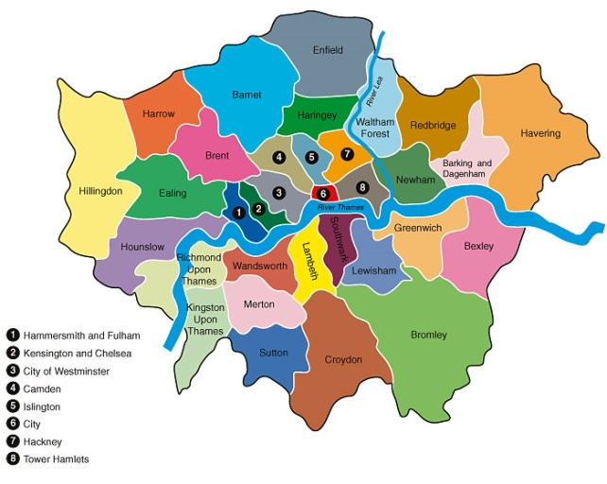
What happens next?
Co-ordinated admissions
all 33 London boroughs and surrounding county councils are included in the co-ordinated admissions process
application lists are exchanged
offer lists are drawn up
offer lists are exchanged

Slide 25
What happens next?
How will places be allocated?
if the school receives more applications than places available, the published admissions criteria will be applied to decide who can be offered a place
each school listed on the application form is considered against the admissions criteria regardless of the preference order
your ranking order is not passed to the individual schools

Slide 26
Offers
Will I be offered more than one school place?
no child will be offered more than one school place
if your child qualifies for more than one school place, you will be offered the school which you ranked higher on your application form
any school ranked as a lower preference than the one you have been offered will automatically be withdrawn and offered to another child

Slide 27
Offers
Are there enough school places available?
Yes
There has been an increase in the demand for secondary school places
This was expected and Barnet has planned for the additional places needed
Every child will be provided with a school place
It may not always be possible to offer a preference school

Slide 28
Offers
When will I hear?
National Offer Day is Wednesday 1 March 2024
you will be sent an email with the result of your application during the evening of 1 March
You can then login into your eAdmissions account for further information

Slide 29
Offers
First round places must be accepted or declined online by 15 March 2023
From 28 March, further offers made to children without places or to late applicants
Second round offers – deadline for applications is 17 March
Second round offer dates 28 – 31 March
Additional offers - after the second round of offers, further offers will be made to children on school waiting lists, as and when vacancies arise.

Slide 30
No Offer?
What happens if I don’t get any of my preferred schools?
your child will be allocated a place at the nearest school with a vacancy
remain on the waiting lists
appeal for a place
join waiting lists for other schools

Slide 31
Appeals
every parent has the right of appeal
appeals are heard by an independent panel
you will have the opportunity to present your case in person
you will need to convince the panel that your child’s needs are more important than the school’s need to limit the admission number
appeals are unlikely to be successful unless there are exceptional grounds

Slide 32
Any questions?

